Slide 1
Coronavirus:
What Kids Can Do
SOURCES:
https://kidshealth.org/en/kids/coronavirus-kids.html?WT.ac=p-ra
Centers for Disease Control and Prevention (CDC)

Slide 2

Wash Your Hands
Use soap and water
Wash for 20 seconds
  Say 2 Hail Mary’s
  Sing Happy Birthday twice
  Count to 20 slowly
Wash the top of your hands, between your fingers, and even your fingernails!
Always wash your hands when you
  come in from outside
  before and after you eat
  after playing with your pet
  after sneezing or coughing
Happy Handwashing Day – (CDC)

Slide 3
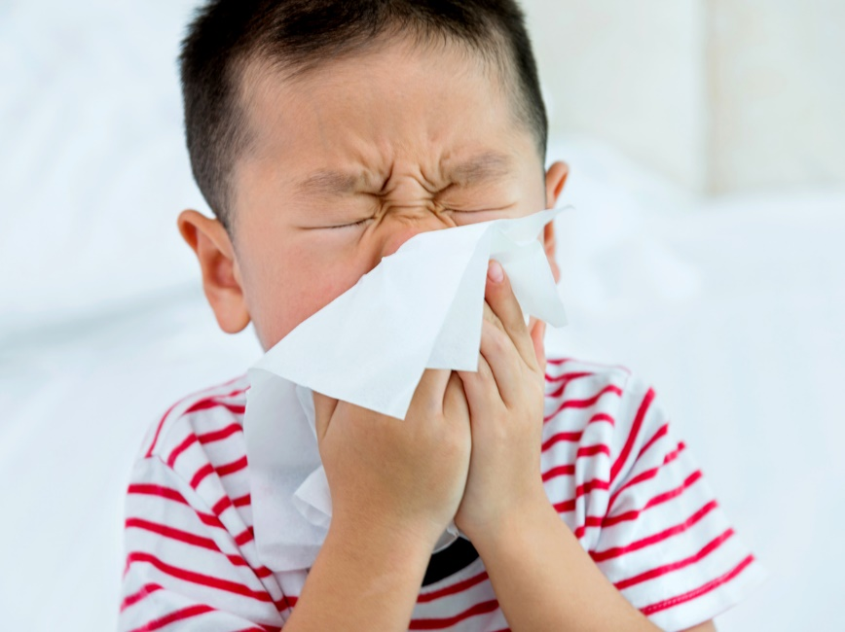
Cover Your
Sneeze or Cough
Sneeze or cough into your elbow not your hands
Sneeze into a tissue and throw it away
Always wash your hands with soap and water!
Cover Your Cough and Sneezes - CDC

Slide 4

Don’t visit others
Don’t go out
Don’t spread the germs!
Stay Home if
You are Sick

Slide 5
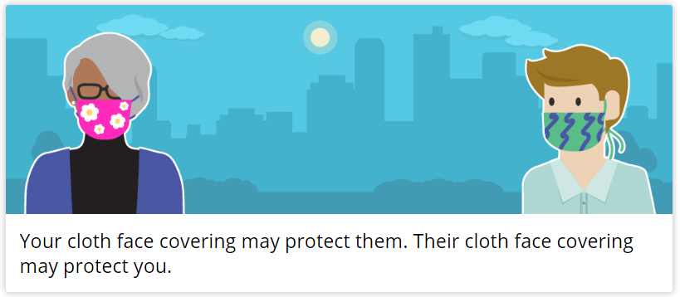
Cover your Face

Slide 6
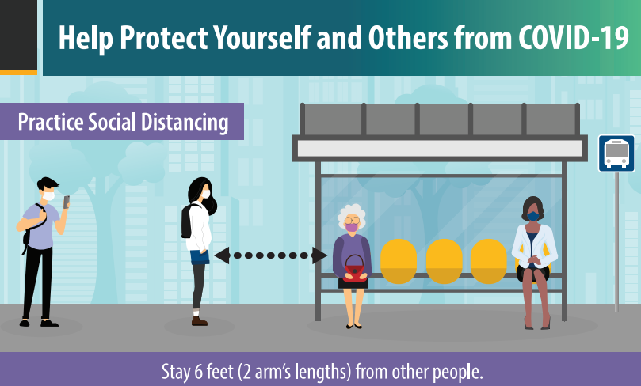
Keep your Distance

