Slide 1
Coronavirus
What Teens Can Do
Sources:
https://teenshealth.org/en/teens/coronavirus-calm.html
Centers for Disease Control and Prevention

Slide 2
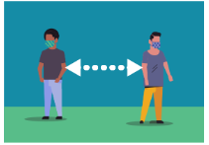
How Does
Physical Distance
Help?
When everyone does it, it slows the spread.
Fewer people get sick at the same time.
Doctors and hospitals can keep up with taking care of people who are sick.

Slide 3
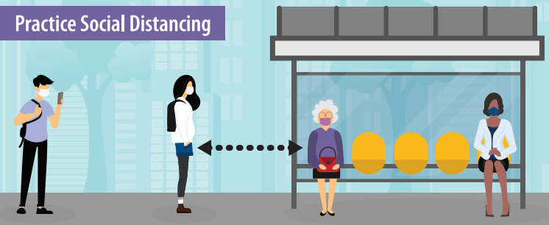
Why is Physical Distancing so Important Now?
COVID-19 is very contagious
Spreads person-to-person
Can spread when someone with the virus coughs, sneezes, or breathes around someone who is too close
Virus can spread even if a person doesn’t show symptoms

Slide 4
What Can I Do?
Keep Distance from….
  Friends
  Classmates
  Teammates
  Neighbors
  Even people in your family you don’t live with
Practice Social Distance
Wear a Face Covering

Slide 5
It’s a Big Change….It’s Not Easy
But….
  It can protect a lot of people
  It can save lives
  It’s worth it!
We Will Get Through This!

Slide 6
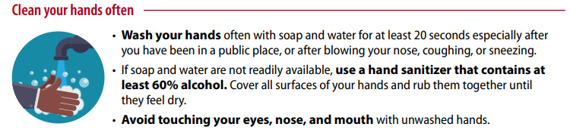
Do Your Part!

Slide 7
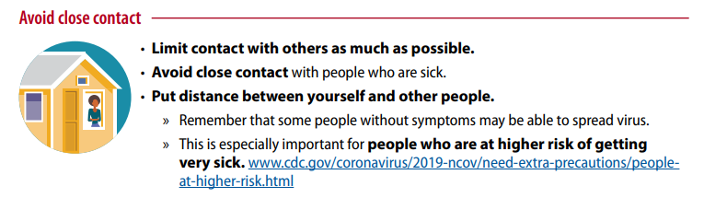
Do Your Part!

Slide 8
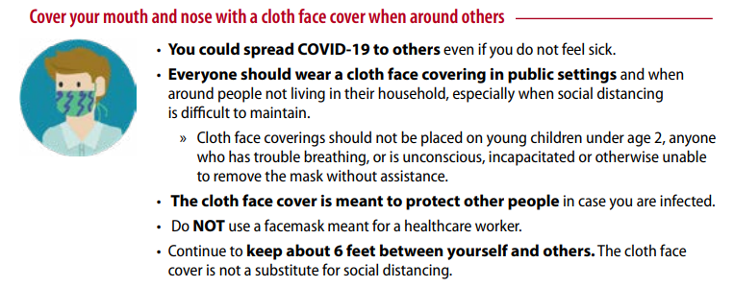
Do Your Part!

Slide 9
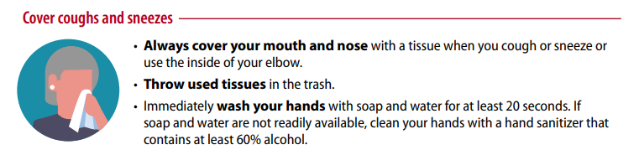
Do Your Part!

Slide 10
We Will Get Through This!

