Slide 1

Celebrating the Jubilee Year
The Jubilee Year of Hope 2025
Date

Slide 2


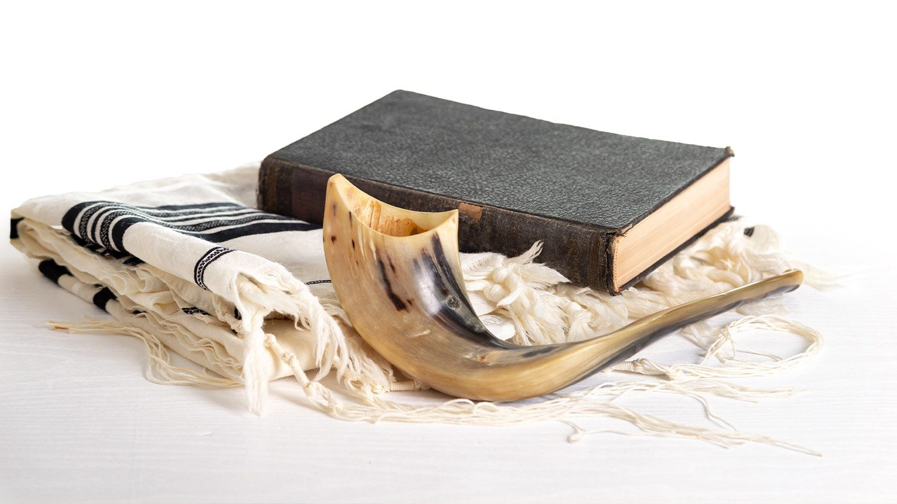
History of the Jubilee Year
The word Jubilee comes from the Hebrew word yobel, which is a ram's horn. This wind instrument is blown to mark the start of a Jubilee Year in the Bible (Leviticus 25:8-10).
You shall count seven weeks of years—seven times seven years—such that the seven weeks of years amount to forty-nine years. Then, on the tenth day of the seventh month let the ram’s horn resound; on this, the Day of Atonement, the ram’s horn blast shall resound throughout your land. You shall treat this fiftieth year as sacred. You shall proclaim liberty in the land for all its inhabitants. It shall be a jubilee for you, when each of you shall return to your own property, each of you to your own family.
www.adwcatholicschools.org

Slide 3
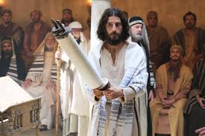
History of the Jubilee Year
In Old Testament times, every 50 years, debts were cancelled, prisoners and enslaved people were freed, and even the land was able to rest.
In the Gospel of Luke, Jesus makes clear his own mission is to bring Jubilee. In the synagogue at Nazareth, he reads from the scroll of the prophet Isaiah, proclaiming the year of the Lord's favor:
He unrolled the scroll and found the passage where it was written: “The Spirit of the Lord is upon me, because he has anointed me to bring glad tidings to the poor. He has sent me to proclaim liberty to captives and recovery of sight to the blind, to let the oppressed go free, and to proclaim a year acceptable to the Lord.” Luke 4: 17b-19
www.adwcatholicschools.org

Slide 4
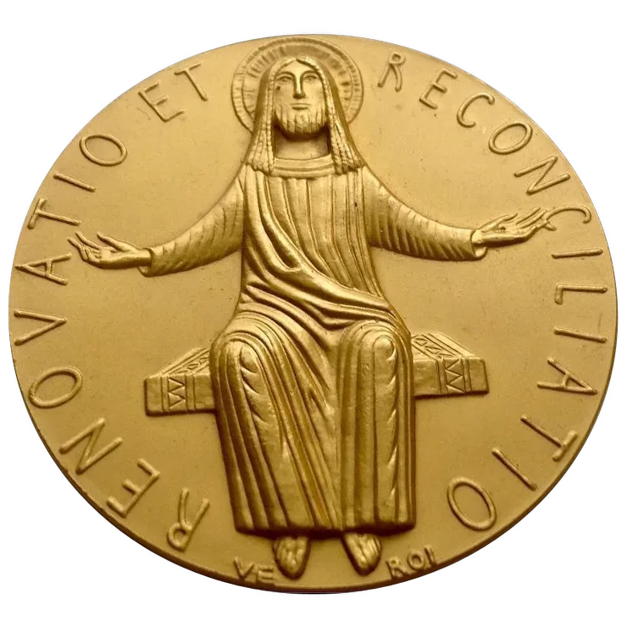


Jubilee in the Catholic Church
The Catholic Church began celebrating jubilees in 1300, when Pope Boniface VIII proclaimed a holy year.
A Jubilee Year is celebrated by the Church every 25 years. This has been the case since 1470, when Pope Paul II changed it from every 50 years.
In the Catholic Church, a Jubilee or Holy Year is a special year of forgiveness and reconciliation, in which people are invited to come back into right relationship with God, with one another, and with all of creation.
www.adwcatholicschools.org

Slide 5
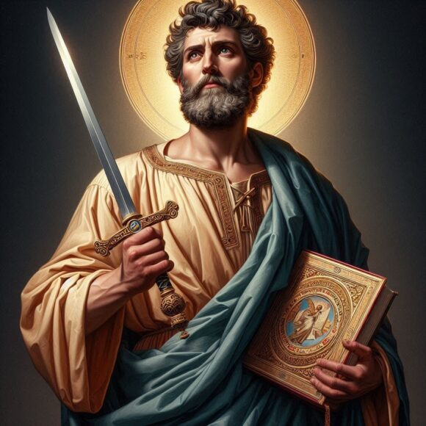
Taking St. Paul’s words as our guide…
“For all of us, may the Jubilee be an opportunity to be renewed in hope. God’s word helps us find reasons for that hope. Taking it as our guide, let us return to the message that the Apostle Paul wished to communicate to the Christians of Rome,”-Pope Francis
"we have fixed our hope on the living god"
“rejoice in hope, be patient in tribulation, be constant in prayer”
“and hope does not disappoint, because the love of God has been poured out within our hearts through the Holy Spirit who was given to us.”
www.adwcatholicschools.org

Slide 6

The story is important
Stories are powerful and give us connection.
When do you remember looking forward to something with “high hopes?”
www.adwcatholicschools.org

Slide 7
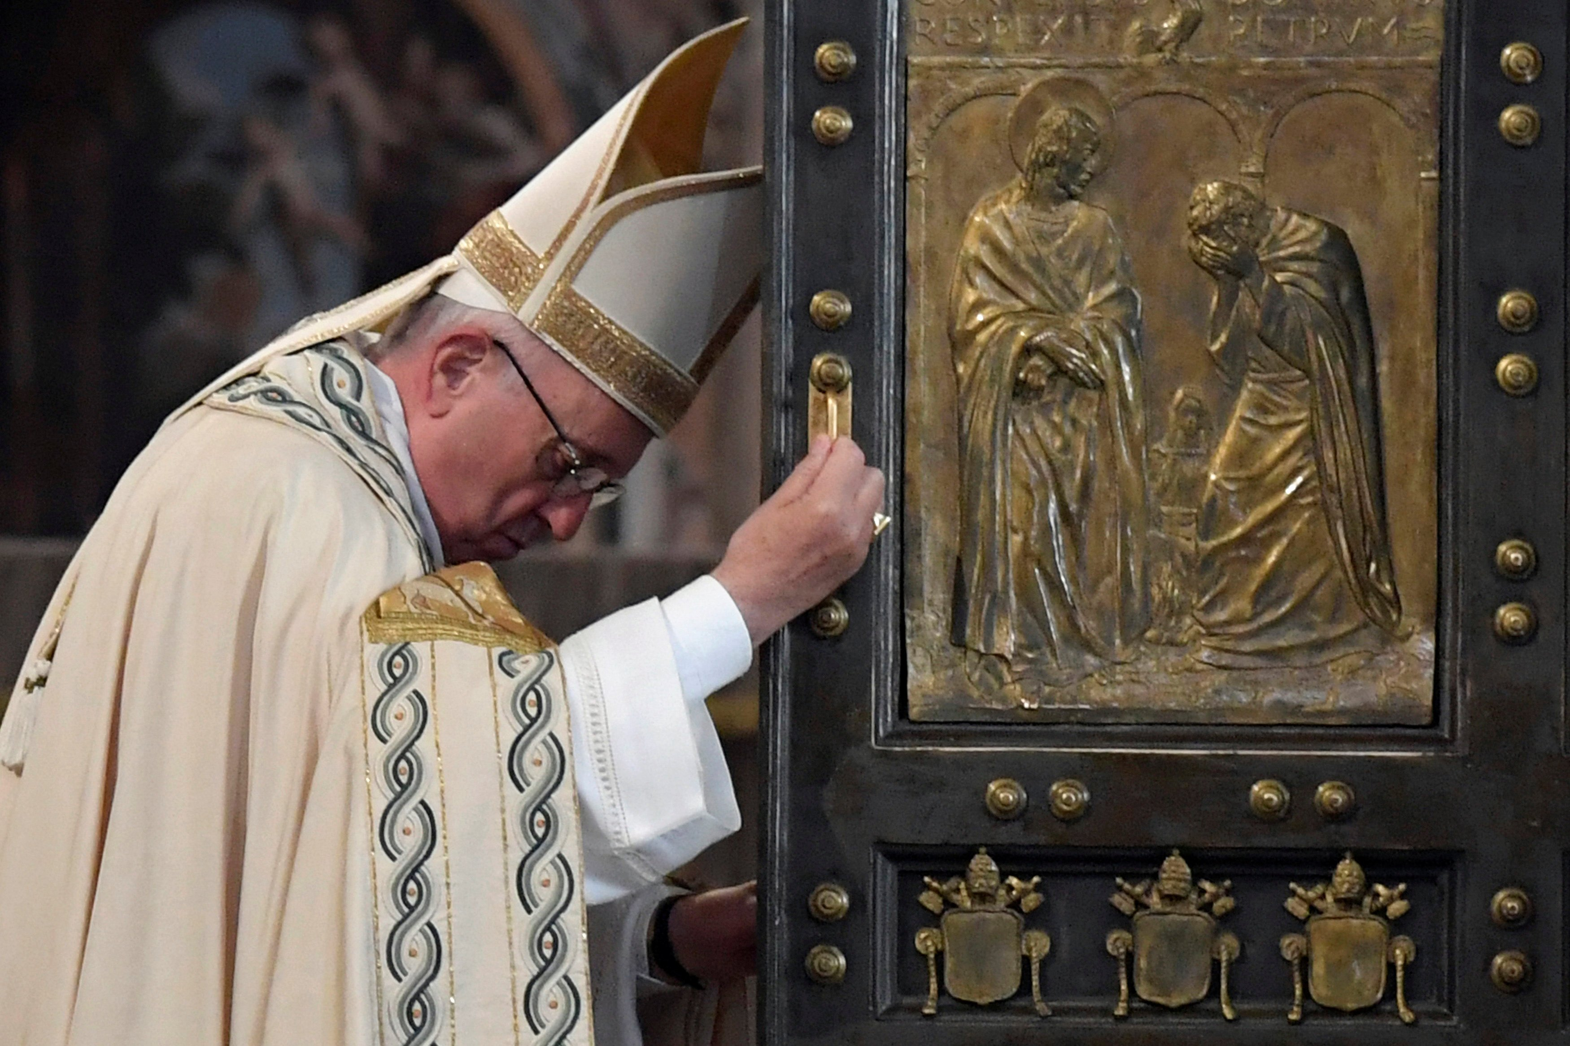
Jubilee 2025- Pilgrims of Hope
Pope Francis has called this Jubilee Year ‘Pilgrims of Hope’. It’s an invitation to renew our hope, a hope which comes from knowing that God loves each one of us, whoever we are.
He has asked us to be signs of hope for others, by putting Catholic Social Teaching into action through caring for our common home and supporting our sisters and brothers who are experiencing war, hunger or poverty.
www.adwcatholicschools.org

Slide 8
Jubilee 2025- Pilgrims of Hope
The cross bends down towards humanity, not leaving human beings alone, but stretching out to them to offer the certainty of its presence and the security of hope.
Four stylized figures, representing all of humanity, coming from the four corners of the earth. They embrace each other to indicate the solidarity and fraternity which should unite all peoples.
The figure at the front is holding onto the cross. It is not only the sign of the faith which this lead figure embraces, but also of hope.
There are the rough waves under the figures, symbolizing the fact that life’s pilgrimage does not always go smoothly in calm waters.
The lower part of the cross which has been elongated and turned into the shape of an anchor which is let down into the waves. The anchor is well known as a symbol of hope.
www.adwcatholicschools.org

Slide 9
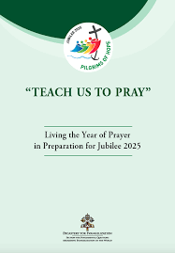
Celebrating the Jubilee
Because Jubilee Years only occur every 25 years, this will be the only opportunity for the students in your school to experience a Jubilee Year within a school setting.
Ideas are broken down into the following categories:
Theme-based activities
Spiritual practices
Community outreach
Educational components
School-wide events
www.adwcatholicschools.org

Slide 10

Jubilee 2025- Meet Luce and Friends!
Aura which means “breeze” in Italian
Iubi is short for Jubilee
Sky
Fe which means “faith” in Spanish
Xin which means “truth” in Japanese
Luce which means “light” in Italian
Santino which is the word for holy cards in Italian
www.adwcatholicschools.org

