Slide 1
Standards based grading
Vicky McCann

Slide 2
Heavenly Father,
As a new year begins,
we stand before you prepared to begin anew
our work as Catholic educators.
Source of all knowledge,
we recognize that you have called us to this important ministry.
We pray that you make us worthy of this call.
Be with us during this upcoming year
as we strive to impart the message of the Gospel
to the students in our care
and make the mission of our schools fully realized.
Grant us wisdom and guidance,
confidence and insight,
patience and a sense of humor.
We ask this through Christ, our Model and Teacher. Amen.

Slide 3





Introductions
Where are you?
Standards Based Grading Pool

Slide 4
Agenda
Teaching to Standards
SBG
  What is it?
  Beliefs
  Rubric
  Benefits
  Grading
  Final thoughts

Slide 5
At the end of this session:
You will have a deeper understanding of teaching to standards, SBG, and why we are doing it.
You will (hopefully) feel more comfortable with SBG.
You will be able to answer parent questions about SBG.
Hopefully, you will feel positively about it too.

Slide 6
First Thing’s First:
Teaching to Standards

Slide 7
Teaching to Standards
Before we can talk about grading standards, we need to talk about teaching to standards.
  The standard is the starting point and activities are built from the standard.
  Every lesson/activity is purposefully done to help students master the skills in the standard.
  Each lesson taught is connected to a standard, and learning targets along the way mark progress toward meeting the standard.
  Assessments are planned ahead of time as well and directly relate to the standard.
  Opportunities to meet learning goals are varied.
  Students know what standard they are learning and why. “I Can” statements.
  The grade book is set up according to standards, not assignments.

Slide 8
Teaching to Standards
What do students need to know, understand, and be able to do?
How will we teach effectively to ensure students learn?
How will we know that students have learned?
What do we do when students don’t learn or reach proficiency?

Slide 9
Teaching to Standards
When you teach to standards:
  students realize exactly what they need to learn and be able to do
  students can take more ownership of and responsibility for their learning
  students must show you that they have met the standard – this is important for an ME or EE
  parents know exactly what their child needs to know and be able to do
  students and parents will know their strengths and weaknesses

Slide 10
Group Project
In groups of 3 or 4, design 3 activities or lessons and at least 2 assessments for the following standard.
Time permitting, groups will report out – what you created, any thoughts on the process
MA.3.NS.5 Compare whole numbers up to 1,000 and arrange them in numerical order.

Slide 11
Teaching to Standards
You need to see the larger picture.
You need to focus both on process as well as product/outcomes.
Think about how you are going to assess the standard as you are planning. Know what your assessments are before you start teaching.
I recommend that you look over the guide sheets and use them.
Know which standards will reappear later in the year.

Slide 12
What is Standards Based Grading?

Slide 13
Standards Based Grading
SBG is a model of grading which uses a rubric system (NE,AE,ME,EE) and is based solely on what the students know and can do.
Standards Based Grading is a refined way of reporting what students know and how they demonstrate their learning of ADW Standards.
SBG is derived from outcomes-based educational practices. A criterion is set up for standards of what every student or child is expected to know (learning), and a score is set compared to these benchmarks rather than a ranking compared to a norm (paraphrased from Wikipedia).
SB grades are used as tools to communicate a student’s progress and reflect the student’s level of knowledge (Mount Vernon Public Schools).

Slide 14
Standards Based Grading

Slide 15
The Rubric

Slide 16
The Rubric
  Level EE – The student can independently and consistently use the knowledge in new ways and in different contexts (transfer). The student may know more than what the standard requires, but this is not always the case - student answers may be more creative, detailed, in depth, and/or sophisticated. Depending on the standard, it may mean that all questions were answered correctly.
  If an EE is given for a quarterly/final grade, the student has mastered grade level expectations independently and most grades on the standards taught are EE’s. The student is well prepared for the next grade level and will probably need acceleration and enrichment.
  Exceeds, above grade level

Slide 17
Level EE
Frequency of behavior – all or almost all of the time
Requires no support to demonstrate understanding
Demonstrates a thorough understanding of the content taught
Makes no errors or omissions when demonstrating concepts or processes.

Slide 18
The Rubric
Level ME – This is what we expect of our students. We celebrate and praise ME’s!!! The student can independently and consistently demonstrate the standard to expectations. However, the student does not have the level of proficiency, sophistication, transfer, and/or application required for a level EE.
If the quarterly/final grade is a ME, the student has mastered grade level standards and is ready for the next grade level. However, there may be a few standards that have not been mastered.
Meets expectations, on grade level

Slide 19
Level ME
Frequency of behavior – most of the time
Requires no or limited support to demonstrate understanding
Demonstrates a general understanding of the content taught
Makes a few errors or omissions when demonstrating concepts or processes

Slide 20
The Rubric
Level AE – The student cannot independently demonstrate the skill or standard consistently; teacher/adult support and assistance is needed.
If an AE is given as a quarterly/final grade, the student is not mastering many/most grade level standards independently. The student may not be ready for the next grade level and will most likely need some additional support and strategies to be successful.
Approaching, performing inconsistently

Slide 21
Level AE
Frequency of behavior – some of the time
Requires moderate support to demonstrate understanding
Demonstrates a partial understanding of the content taught
Makes some errors or omissions when demonstrating concepts or processes

Slide 22
The Rubric
Level NE – The student cannot either independently or with support demonstrate the skills in the standard.
If a NE is given as a quarterly /final grade, the student is not mastering grade level standards and most grades on the standards are NE’s. This student is definitely not ready for the next grade level and will need intensive support and strategies to make growth. This student may also require referral for special education testing if other strategies aren’t working.
Emergent, developing, below grade level

Slide 23
Level NE
Frequency of behavior – seldom or never
Requires considerable support but rarely demonstrates learning
Demonstrates limited to no understanding of the content taught
Makes frequent errors or omissions when demonstrating concepts or processes

Slide 24
Olivia's Explanation of the Rubric

Slide 25
The Rubric in Kid Friendly Language
Level EE – I’ve got it and I can use it! I can even tell you more about it!
Level ME – I’ve got it!
Level AE – I need some help with this!
Level NE – I just don’t get it!

Slide 26
ADW Rubric
Level EE – Your child is exceeding expectations for this standard or subject and can demonstrate the knowledge independently, consistently, and in new contexts.
Level ME – Your child is meeting expectations for this standard or subject independently.
Level AE – Your child is only meeting basic standards and is not meeting expectations for this standard or subject independently or consistently. Teacher support is needed.
Level NE – Your child is not meeting expectations for this standard or subject independently or with teacher support.

Slide 27
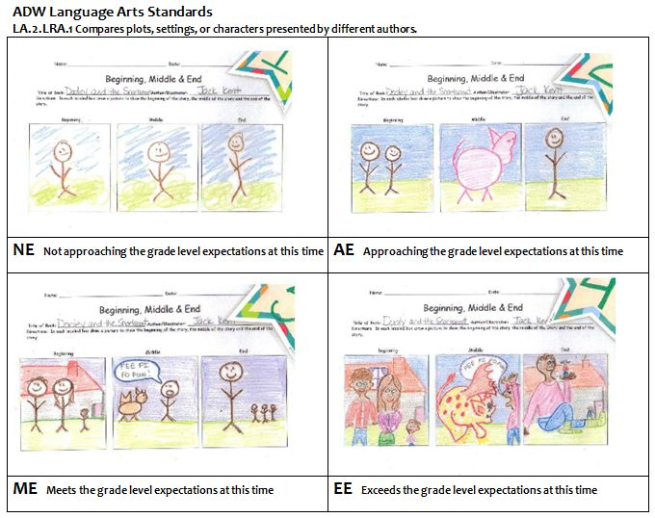
Sample Grade 2
Grading Rubric
Notes:
Let teachers know that they can/should have something like this for students to see.
Also, this would be the grading for just one quarter because the expectation would change the next quarter.

Slide 28
Benefits of SBG

Slide 29
Benefits of SBG
The grades are more meaningful and clearer. What does an 85 tell you?
What does a ME tell you?
All students have the opportunity to earn an EE (high grade).
Parents will know exactly what is being taught and how their child is doing on those skills.
We can focus more on quality because rubrics are used.
Specific feedback must be written on graded work.
There is a focus on mastery while giving students time to learn.
Allows for more consistency across grade levels

Slide 30
“No studies support the use of low grades or marks as punishments. Instead of prompting greater effort, low grades more often cause students to withdraw from learning.”
T. R. Guskey and J. Bailey

Slide 31
Benefits of SBG
The standards are listed on the report card.
You can have more focused and clear conversations with parents because the grades are based on standards.
The grades are based only on what students know and can do.
Grades are never used as punishment. No zeros ever!
A child’s strengths and weaknesses are very evident to parents and teachers.
Students earn the grade that they should earn based on their knowledge. Nothing else clouds the grades…extra credit, behavior, bad handwriting, etc.
It allows students to shine and show talents that are hidden in traditional grading.

Slide 32
“The appropriate consequence for failing to complete an assignment is completing the assignment. That is, students lose privileges, free time, and unstructured class or study hall time, and they are required to complete the assignment. The price of freedom is proficiency…”
D. B. Reeves

Slide 33
Benefits of SBG
It more accurately represents real world experience – meeting standards, having time to improve.
Not cumulative
The grades are a more accurate picture of the student’s current abilities and mastery.
Extra credit is not necessary.
Formal and informal assessments are referred to as opportunities for students to demonstrate their learning and mastery.
Averaging is not needed.

Slide 34
“Teachers turn things in late all the time, as do workers in every profession. The idea that you can’t get away with turning work in late in the real world isn’t true.”
R. Wormelli

Slide 35
Grading in a SB System
Standards

Slide 36
“Evaluation experts stress that if you are going to make important decisions about students that have broad implication, such as decisions involved in grading, then you must have good evidence…In the absence of good evidence, even the most detailed grading and reporting system is useless.”
T. R. Guskey and J. Bailey

Slide 37
Grading Examples - Standards
Level EE
  The standard says the student should be able to write a summary of a book/story that was read. What would an EE response look like?
  An EE response could have the following characteristics: longer, more detailed, perfect/near perfect grammar, spelling, creativity, incorporates prior learning, deeper vocabulary, correct structure, well organized, invokes feelings in the reader, connects with the reader, audience is acknowledged and known, sophisticated and varied sentence structure. The answer demonstrates skills that possibly have not been taught yet and the answer is better than what is expected at this time in the year.
  The standard says the student should be able to count to 300. What would EE response look like?
  An EE response could be that the student can count to a much higher number and can manipulate the numbers while counting by using skip counting, starting from different numbers, counting backwards, etc. The student can also apply counting to 300 to solve problems and can explain his/her thinking and strategies when doing so.

Slide 38
Grading Examples - Standards
Level ME
  The standard is to count to 200. What would a ME look like?
  The student can do this independently. The student may be able to count a bit higher, but transfer to other settings and the use of the skill in different ways is not present. The response is what we expect.
  The standard is to explain the difference between 3 characters. What would a ME look like?
  The student can do this, but the answer does not have the detail, clarity, accuracy, creativity, and/or depth of an EE response.

Slide 39
Grading Examples - Standards
Level AE
    The standard is to name 4 characteristics of a triangle. What would an AE look like?
    The student can’t do this without teacher/adult support or can only name one or two without support.
    The standard is to state 3 characteristics of a non-fiction book. What would an AE response look like?
    The student can only list 1 or 2 on their own and needs help to list 3.

Slide 40
Grading Examples - Standards
Level NE
    The standard is to use addition to solve problems. What would a NE response look like?
    The student cannot do this either independently or with support. Reteaching, time for practice, extended support, and differentiated strategies are needed.

Slide 41
What Does This Look Like?
You will have students who meet the standards/can demonstrate what you want them to know and do.
You will have students who don’t meet the standards/can’t or need help demonstrating what you want them to know and do. You will be reteaching and reassessing them.
Discussion: What can you do with the students who already “know it” while you’re working with the students who don’t? How will you do it?

Slide 42
What factors might you consider when deciding when to stop assessing a student on a particular standard?
Talk with others at your table about this and
be ready to share with the group.

Slide 43
Notes:
What factors might you consider when deciding when to stop assessing a student on a particular standard?

Slide 44
Important Reminders when Grading
Once students earn at least a ME and can demonstrate the content consistently, assessment can stop.
A zero is never given. That is a punishment and has nothing to do with what the student knows. Teachers should address the behavior of not completing work in different ways.
Don’t penalize students for being absent.
Emphasize improvement.
Do not take off points for lateness, incomplete work, etc. That should be addressed separately.
Do not tell parents that an EE is not possible because it’s the beginning of the year or that only a few students get an EE.

Slide 45
Important Reminders when Grading
Give students plenty of risk-free practice before assessing.
Never give a student a AE or NE because you are still teaching the standard. That is impossible to defend! Don’t grade it until you have given the student sufficient time and opportunities to demonstrate the content.
Doing more does not get students a higher score. Knowing more and demonstrating that does.

Slide 46
“By comparing one child’s performance to a clear standard, parents, children and teachers all know precisely what is expected. Every time a student attempts a task, the performance is compared to the standard, not to other children’s performances. The most important advantages for children and families are fairness, clarity, and improved learning.”
Doug Reeves

Slide 47
Grading on Assessments
I prefer to call assessments or any assignment that is being graded an observation or evidence.
You will get to make your own rubrics, just like always.
The rubrics will vary depending on the standard(s) assessed, the type of test, subject, and number of questions. Use written rubrics for longer assignments.
On some assignments, an EE may not be possible. For example, if the standard states that students should be able to write the numbers from 1 – 300, if the student does this it’s a ME.
But, you can and should offer EE opportunities. For the above standard, you would include more blanks to give students a chance to count higher. If they can, an EE could be given.

Slide 48
Grading in SBG

Slide 49
Grading for the Quarter or Final Grade

Slide 50
Grading for the Quarter or Final
It is important to look at all the assignments for a standard as a whole, without averaging. Teachers should ask themselves: What rubric score represents this students’ overall proficiency in this standard this quarter?
The mode is often the appropriate grade, but not always.
If some standards haven’t been assessed in awhile and are showing the student to be not proficient, you should reassess or at least have a plan for reassessing in the future and share this with parents.
However, key or important standards and your knowledge of the student may be considered and factored into a final grade.
The key to this is being able to explain and justify the grades to parents.
Comments need to be specific and tied to the standards. Any grade of NE or AE should have comments stating why.

Slide 51
Grading Examples – Quarter/Final
  Jocelyn’s performance on the standard taught:
  ME, ME, AE, ME, ME, EE, ME Final grade: ME Why?
  Lisa has mastered most of the assignments. On one assignment she performed above expectations, but on another she still requires practice and reteaching. However, her overall performance is what we expect.
  Lisa’s performance on the standard taught:
        ME, EE, ME, EE, ME, EE Final grade: ? What do you think?
        The teacher’s knowledge of the student will come into play here, as well as the importance of each assignment.
    Kyle’s performance on the standard taught:
  ME, ME, EE, ME, EE, ME, ME, ME Final grade: ME Why?
  Kyle has mastered the assignments and met expectations. On some of the assignments he has demonstrated additional skill, knowledge, and creativity, but overall his performance is what we expect.

Slide 52
Grading Examples – Quarter/Final
  Isaac’s performance on the KEY standard: (Key Standards are standards on the Report Card)
  EE, AE, EE, EE, EE, EE, AE Final grade: EE Why?
  Isaac obviously is performing above grade level on many assignments and can use the information and his knowledge in different ways. However, there are a few assignments on which he still needs more practice, but this does not affect his overall knowledge and proficiency.
  Interesting to note: averaged the grade would be a ME!
  Eva’s performance on the standard taught:
  AE, AE, AE, ME, AE, ME, ME Final grade: AE Why?
  Eva has performed at a level AE on many assignments, including two key or important ones. She is not demonstrating that she has overall mastery of the content yet, although she has mastered a few of the assignments.

Slide 53
Grading Practice for Quarter/Final
ME, ME, AE, ME, ME, EE, ME Final grade? ______
AE, ME, AE, ME, AE, AE, ME Final grade? ______
ME, ME, ME, EE, EE, ME, ME Final grade? ______
EE, AE, EE, EE, EE, EE, AE Final grade? ______
ME, ME, ME, EE, EE, EE Final grade? ______
EE, EE, EE, ME, ME, ME Final grade? ______
Remember that these grades may differ once knowledge of the student is considered and ample evidence must exist to support the grade.

Slide 54

Let’s talk about Rediker and your gradebook!
It’s for more than just attendance!

Slide 55
How do standards transfer to the report card?
Standards are “unpacked”, or taken apart, so that students can understand it.
Standards are EOY goals, so they are taught and assessed in pieces.
Guide Sheets break the report card standards down.

Slide 56
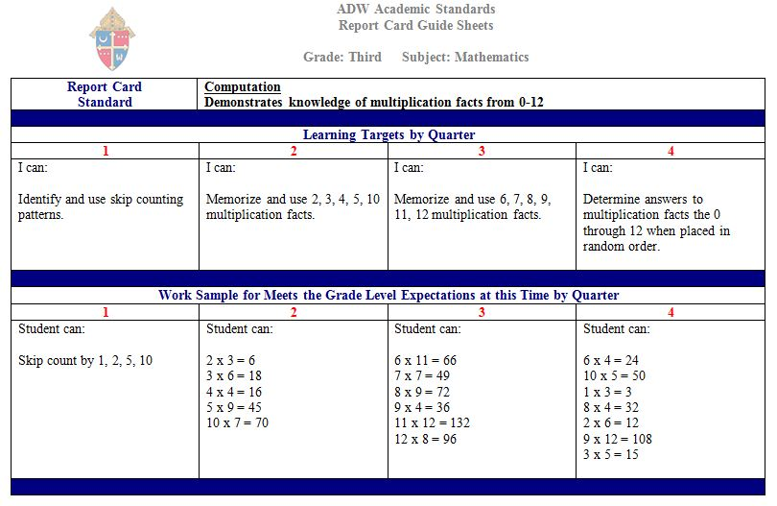
Sample ADW Guide Sheet
Notice how the standard is broken down into the four quarters with a different learning target each quarter.

Slide 57

Grading in Rediker
Use the Guide Sheets to help you plan your lessons
Score for standards you have ASSESSED
You only put scores into the Skills/Standards portal at the close of each quarter
Use the most recent data

Slide 58
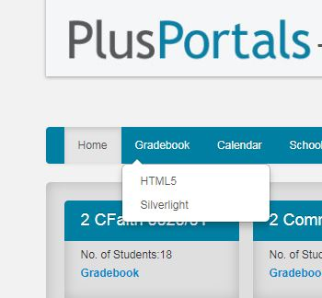
Accessing Gradebooks
Log into your account.
Click on the “Gradebook” tab.
In the dropdown menu, select “HTML5”.
This will take you to the “attendance” screen for your most recent gradebook.

Slide 59
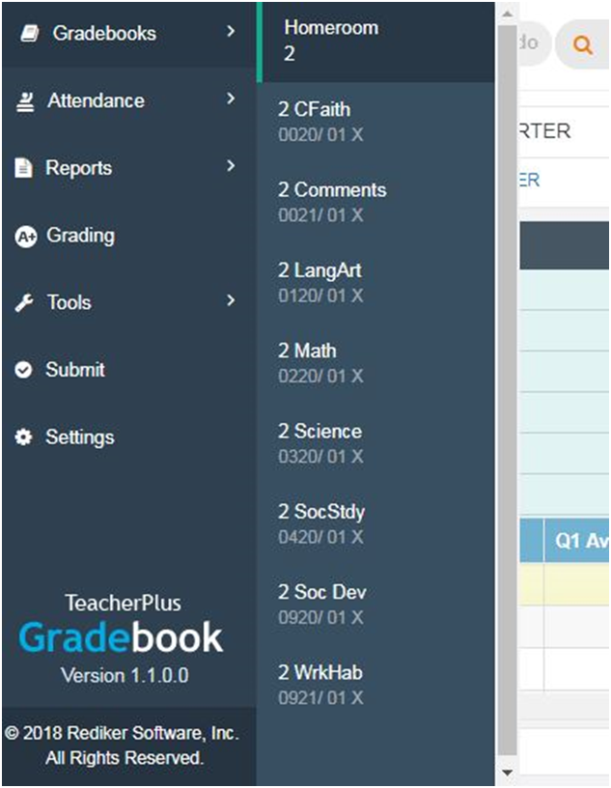
Click on “Gradebooks” on the left-hand side.
Select the gradebook that you are adding grades to.
DO NOT add grades to the Homeroom section of Rediker.

Slide 60
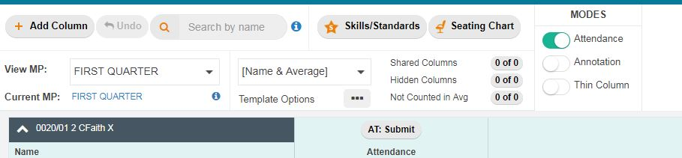
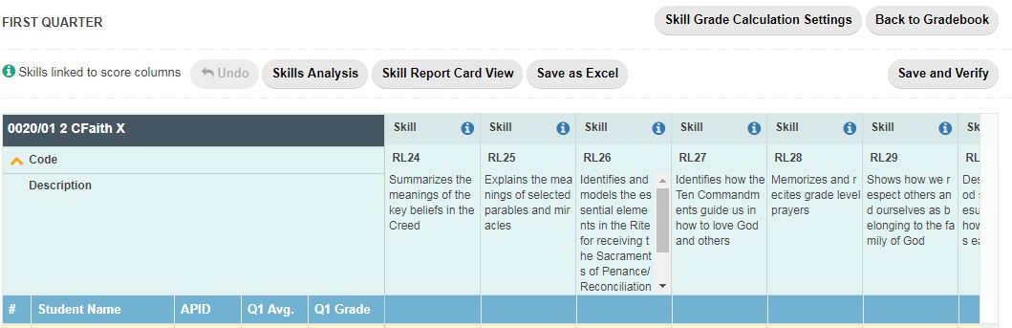
Click on the “Skills/Standards” button as shown in the picture above.
A screen similar to the one below will appear showing the report card standards.

Slide 61
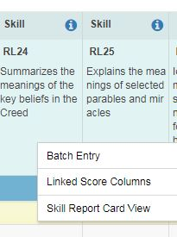
Entering a Quarterly Grade
Options:
Enter grades individually in the boxes next to the student names.
“Batch” enter grades as ME and make changes to students that don’t fit into that category.**
**Right click anywhere here to see this pop-up menu to make a Batch Entry.

Slide 62
Are you ready to practice
with the sample you brought?
Work with your neighbors to create rubrics for your assignments.

Slide 63
Final Thoughts on SBG

Slide 64
“The best thing you can do is make sure your grades convey meaningful, accurate information about student achievement. If grades give sound information to students, then their perceptions (and) conclusions about themselves as learners, and decisions about future activity will be the best they can be.”
S. Brookhart

Slide 65
Keep in Mind…
SBG does not translate to assessment based grading methods. A EE does not mean an A or 95%. Discourage parents from associating them.
Every student is expected to earn a ME on each standard, and you should work to help students who earn NEs and AEs to achieve a ME. Reteaching, reassessing.
Although ME is what should be expected and praised, we need to believe that ALL STUDENTS CAN GET A EE DEPENDING ON THE STANDARD.

Slide 66
Keep in Mind…
Give the students “Level EE Opportunities” whenever possible.
Grades should not be averaged.
You can (and should) teach multiple standards in your lessons. It is expected that all standards will be covered during the year.
With SBG we focus on what we want the student to know and be able to do now. We don’t measure them against where we want them to be at the end of the year.
Students are not penalized for the time that it takes them to learn the skills/information in the standard.

Slide 67
Keep in Mind…
You need to keep accurate and detailed records of each student’s performance. These should include notes, assessments, and work samples. You need to be able to justify the grades to the parents.
Since grades are standard dependent, they may fluctuate from quarter to quarter.
All students must complete the work. That keeps the emphasis on LEARNING. Giving zeros/not accepting late work teaches students how to avoid doing the work and accepts lack of motivation. It also denies the students an opportunity to learn!

Slide 68
thanks!
Any questions?
You can find me at
@adwcurriculum
mccannv@adw.org
410-853-4548

