Slide 1
SAT Response to Bullying
Creative Ideas

Slide 2
When Jesus came ashore a man from the town who was possessed by demons met him. For a long time he had not worn clothes; he did not live in a house, but lived among the tombs. When he saw Jesus, he cried out and fell down before him; in a loud voice he shouted, "What have you to do with me, Jesus, son of the Most High God? I beg you, do not torment me!"
For he had ordered the unclean spirit to come out of the man. (It had taken hold of him many times, and he used to be bound with chains and shackles as a restraint, but he would break his bonds and be driven by the demon into deserted places.)
Then Jesus asked him, "What is your name?" He replied, "Legion," because many demons had entered him. And they pleaded with him not to order them to depart to the abyss. A herd of many swine was feeding there on the hillside, and they pleaded with him to allow them to enter those swine; and he let them.
The demons came out of the man and entered the swine, and the herd rushed down the steep bank into the lake and was drowned. When the swineherds saw what had happened, they ran away and reported the incident in the town and throughout the countryside. People came out to see what had happened and, when they approached Jesus, they discovered the man from whom the demons had come out sitting at his feet. He was clothed and in his right mind, and they were seized with fear.
Those who witnessed it told them how the possessed man had been saved.
The entire population of the region of the Gerasenes asked Jesus to leave them because they were seized with great fear. So he got into a boat and returned.
Luke 8:27-37

Slide 3
In regard to Luke 8:27-37
1. If you feel someone is being bullied in this story, discuss the following –
Who is being bullied?
Who is doing the bullying?
Why are they bullying?
What is the result of the bullying?
2. If you feel that no one is being bullied in this story, discuss the following –
What word would you use instead?
Why are the townspeople afraid?
Why do they send Jesus away?

Slide 4
Bullying involves many different people and systems…
The bully
The child being bullied
The families of these two children
Any children who are on-lookers
The peer group(s) of these two students
The teachers/adults in the school
The school culture
The community culture

Slide 5
Be careful with generalizations, but…
Boys tend to bully in physical ways
Girls tend to bully in social ways
Children with health problems or special needs are at greater risk for becoming targets
Children who are under academic stress or other stress tend to bully
Children with poor social skills or children who are shy or introverted tend to become targets
Some children are both bullies and targets

Slide 6
Bullying and Excessive Absences
Bullying can be one explanation for why a child does not want to go to school or develops physical symptoms that are difficult to pin down, like stomach aches or headaches.
Children may also not want to go to school for other reasons, including separation anxiety or fear about academic performance.

Slide 7
What can an SAT do?-
Collect data.
This can be data you would see anyhow or data that you collect.

Slide 8
Collecting Data on any one of these variables can help you plan effectively:
Are their patterns involved, in regard to –
Location
Time of Day
Ages of students involved
Seasons of the year

Slide 9
http://www.teachsafeschools.org/bully_menu3.html#7
Assessment tool for SAT use.

Slide 10
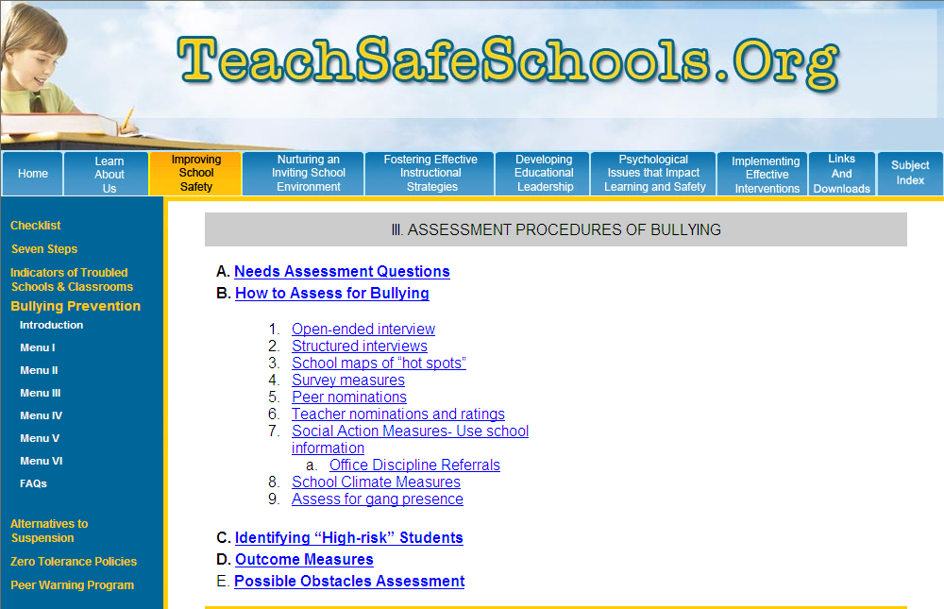

Slide 11
Dr. Susan Swearer, University of Nebraska:
The question that I ask students, parents and educators is:
“What are the conditions in your school (family, community) that allow bullying to occur?”
The answers to that question are then the areas to address for intervention. We write about how to do this in our book Bullying Prevention and Intervention: Realistic Strategies for Schools (by Susan Swearer, Dorothy Espelage and Scott Napolitano, published in 2009 by Guilford Press). Interventions should be based on evidence. Since bullying will vary across schools and communities, each school in this country ought to be collecting comprehensive data on bullying experiences.

Slide 12
What can an SAT do?
2. Write into the student plans (CAP or ICEP) strategies that will help students avoid bullying or being bullied.

Slide 13
http://foxborough.k12.ma.us/assets/files/district/FPS-Bullying-Prevention-and-Intervention-Plan-2010.pdf
Above is a sample plan that was used by many Massachusetts Schools systems. It involves the use of the team to identify students who are at risk and to write into their plans methods to help prevent them becoming bullies or victims.

Slide 15
Plans can include:
How unstructured parts of the day (recess, lunch, passing in the hallway) will be handled for this student.
Training student will receive regarding social skills or speech pragmatics.
Monitoring – assume that misbehavior may be linked to struggling in school.
Using Creative Communications videos as homework, as a consequence to a child who has been bullying, or for a family to watch and discuss.

Slide 16
What can an SAT do?
3. Write the expectations that you have for parents into the plans for individual children.

Slide 17
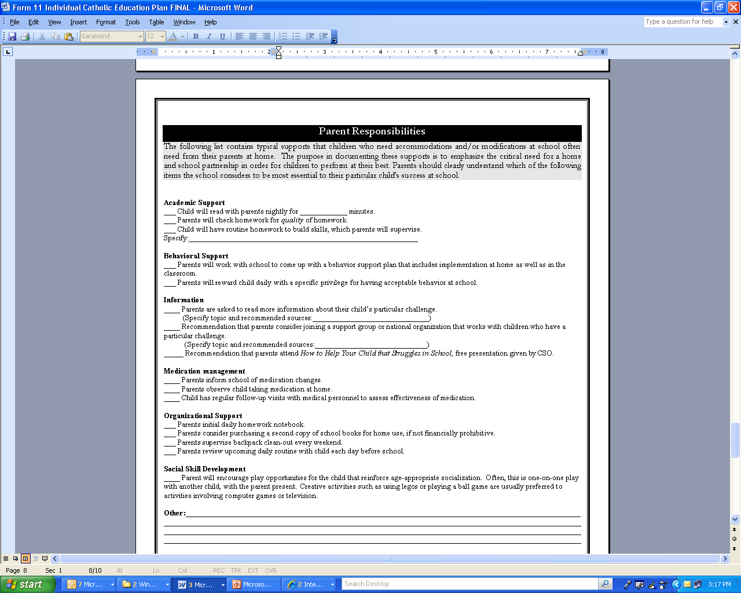

Slide 18
http://www.annunciationcatholicnc.org/index_htm_files/2011-2012_Parent_Student_Handbook.pdf

Slide 19
http://www.missiongrammar.org/Bullying%20Policy%20and%20prevention%20plan-2.pdf
16 page “Anti-bullying” plan from Our Lady of Perpetual Help Mission Grammar School in Roxbury, MA includes use of the SAT to write a specific plan.

Slide 20
What can an SAT do?
4. Support staff development regarding the culture and climate that tends to reduce bullying.
This could be individual conversations one-on-one or recommendations to the principal regarding staff development.

Slide 21
Pastoral Care Plan
http://web.majella.wa.edu.au/images/pdf/Majella%20Anti-bulllying%20Policy.pdf
Majella Catholic Primary School
Balga, WA

Slide 22
Pastoral Care Plan
St. Francis of Assissi elementary school
Warrawong Australia

Slide 23
What can an SAT do?
5. Model confidentiality

Slide 24
Confidentiality
http://www2.ed.gov/policy/gen/guid/fpco/ferpa/index.html
FERPA3590 Maintenance and Confidentiality of

Slide 25
3590 Maintenance and Confidentiality of Archdiocesan School Student Records
All Archdiocesan Catholic school student records shall be the responsibility of the chief administrator and the property of the school. Maintenance and security of all student records shall comply with Archdiocesan guidelines. Archdiocesan Catholic schools shall fully comply with the provisions of the Buckley Amendment regarding confidentiality and security of student records (Family Education Rights and Privacy Act of 1974).

