Slide 1

Introduction to
Presented by Chris Buchleitner
Assistant Superintendent of School Operations and Student Services

Slide 2
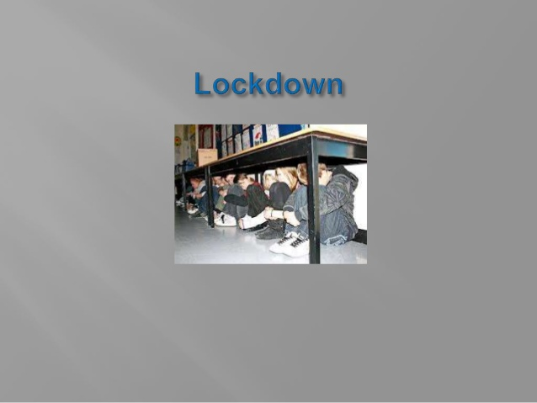
Why A.L.I.C.E.?

Slide 3
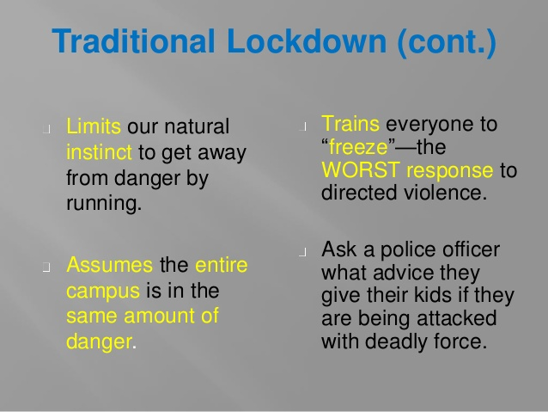

Slide 4
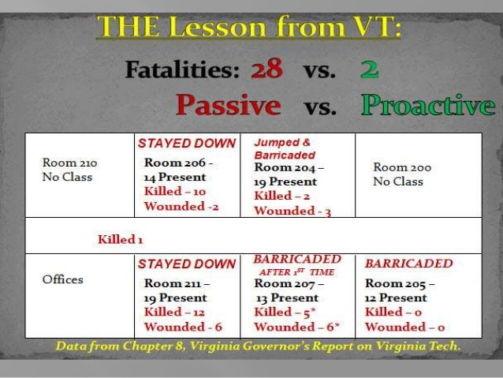

Slide 5
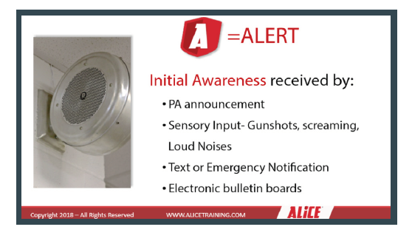

Slide 6
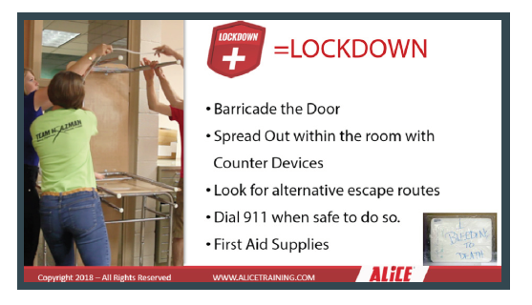

Slide 7
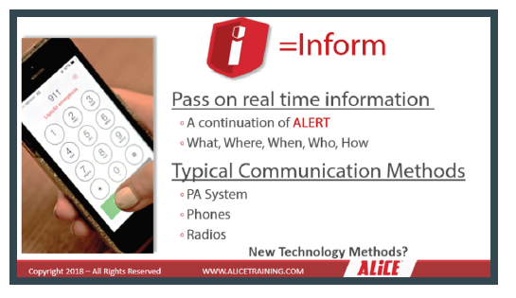

Slide 8
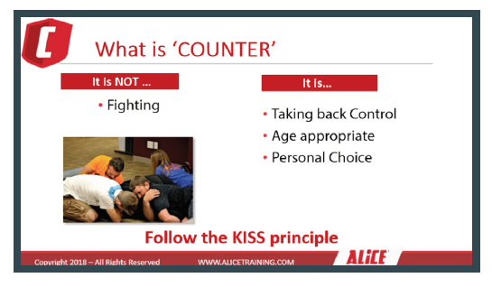
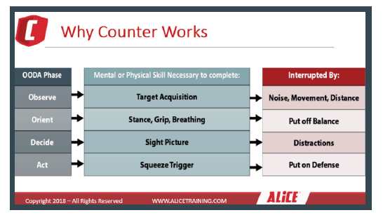

Slide 9
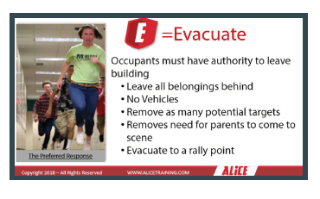

Slide 10
Questions?

Slide 11
The End
Resources:
Alicetraining.com

