Slide 1
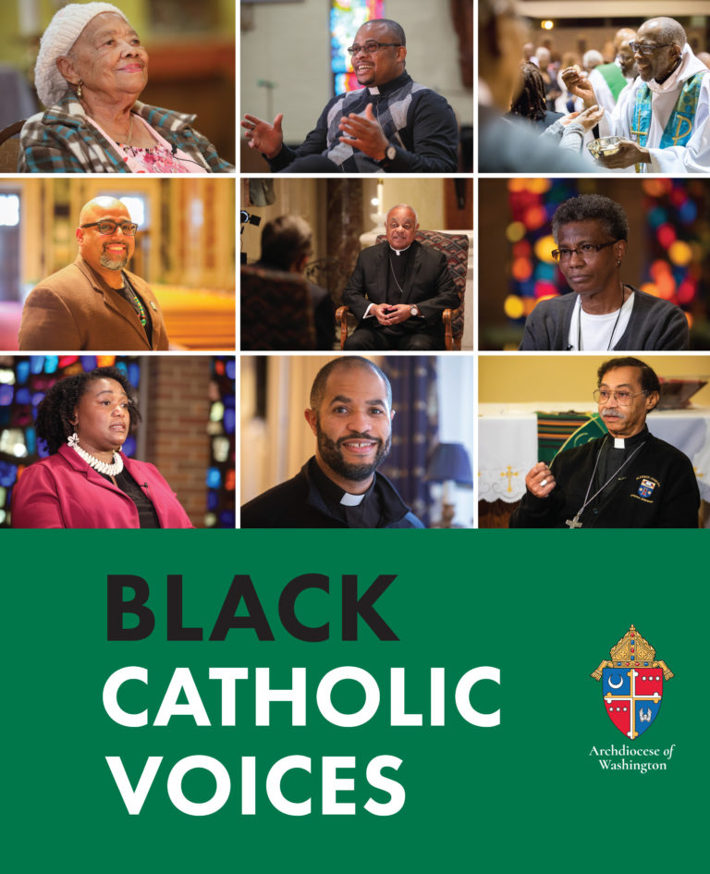
Fr. Robert Boxie III
Priest, Catholic chaplain Howard University
Faith Formation, Courageous Conversations, and Racial Understanding

Slide 2

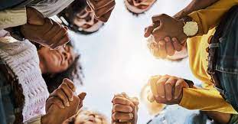
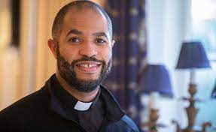
Objectives:
Students will gain understanding of faith’s role in promoting social justice and racial equality.
Students will design their own banner/sign to depict how they can promote peace and healing in the world.

Slide 3
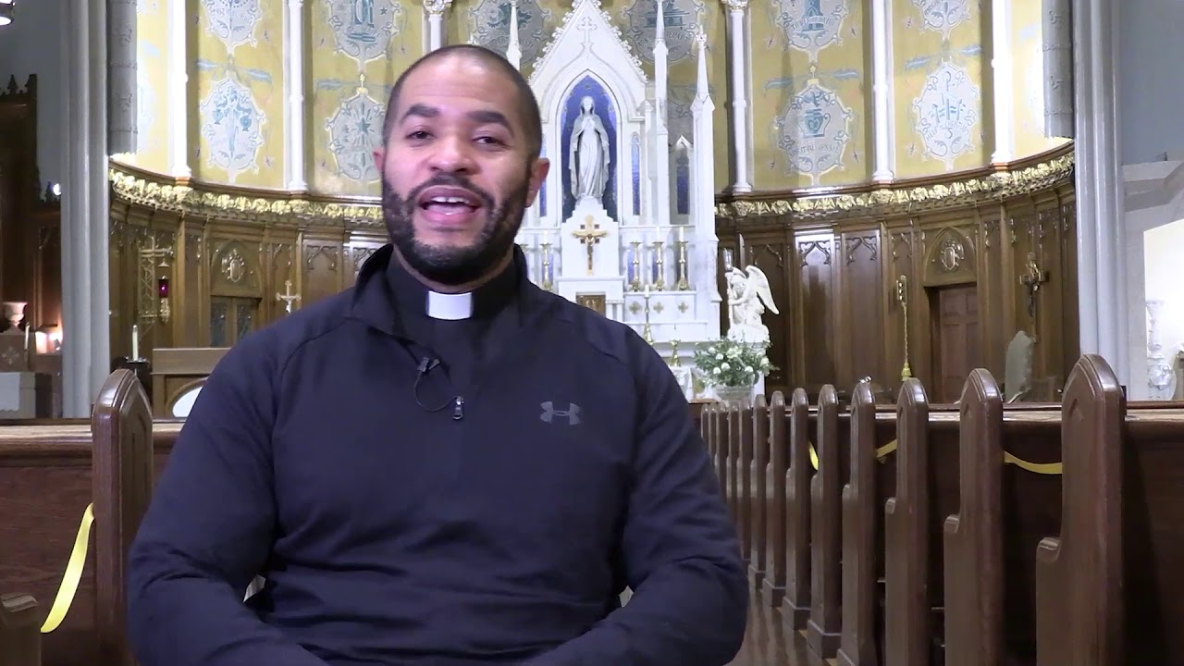
View this conversation with Fr. Boxie as he reflects on his faith formation, identity as a black catholic, and experiences with racism.

Slide 4



What is perseverance?
How does Fr. Boxie explain his witness of faith among the black catholic community?

Slide 5


Are there instances of racism that you have experienced in society or the Catholic Church that remain painful memories?
What was Fr. Boxie’s experience with racism while he attended seminary?
How was he courageous?
How did his faith guide him?

Slide 6

What gives you hope for a better future for our Church and for our country?
“What has allowed me to keep the faith in my country and also my Church – well, first and foremost, the answer is very simple, it’s Jesus Christ. This is His Church. This is His people. This is His world. And so the fact that He has already conquered it, we have faith and trust in that. And for my part, I just have to be faithful to my vocation, to my ministry, to doing all that I can with God’s help to help bring about this kingdom of love, of service, of reconciliation, of peace. So Christ is my hope.”

Slide 7
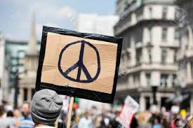

Create a banner or sign that displays how you can promote peace and healing in the world.

