Slide 1
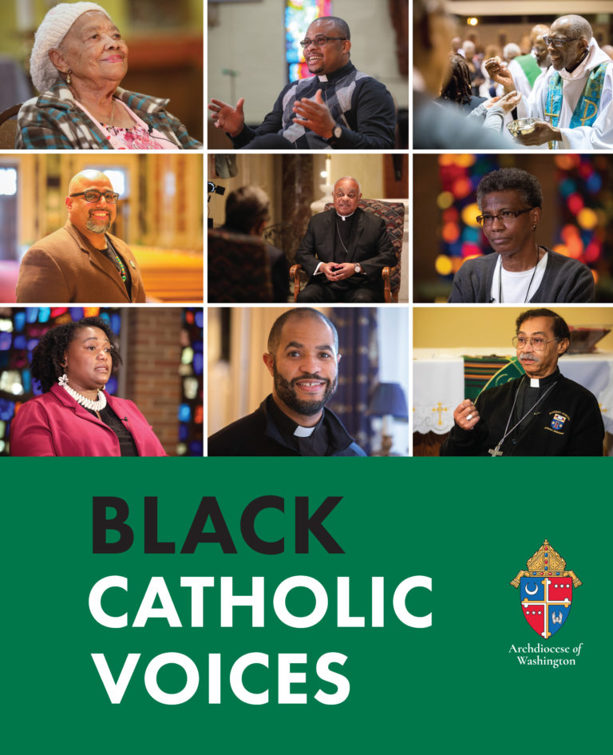
Ms. Deana Grant
Lifeflong member St. Augustine Parish, Washington, D.C.
Faith and Service

Slide 2

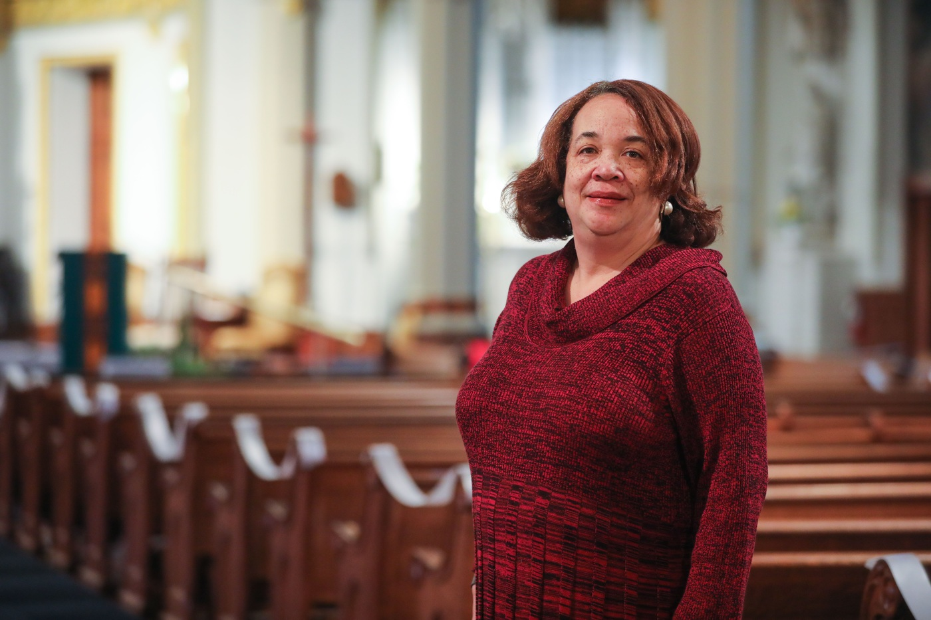
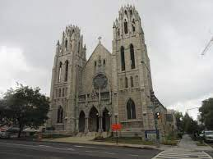
Objectives:
Students will gain understanding of faith’s role in promoting social justice and racial equality through community service.
Students will create a pictorial representation of a community service project.

Slide 3
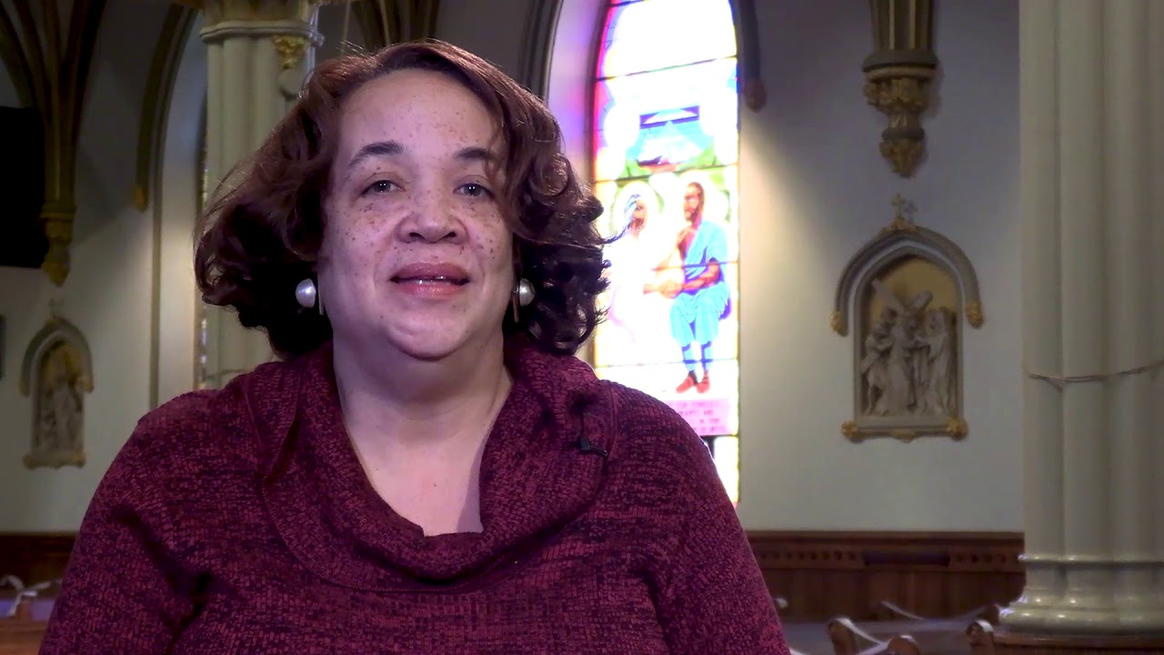
View this conversation with Deana Grant as she discusses her faith, service, and identity as a black catholic.

Slide 4


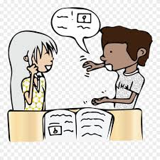
What are some examples of service Ms. Deana Grant is involved in through her parish St. Augustine?
How do her acts of service help the community?

Slide 5


What do you think Catholics should do, what should the Church do (to address racism)?
What does racism mean? How can it be addressed?
Ms. Deana Grant believes the church should admit their role in racism so we can discuss it and begin to move on.

Slide 6

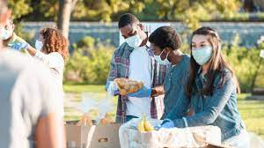
How can you spread faith, hope, and love in your community?
Think of a service project that will spread’s God’s love in your community. Create a detailed and labeled picture of your idea.

